Slide 1
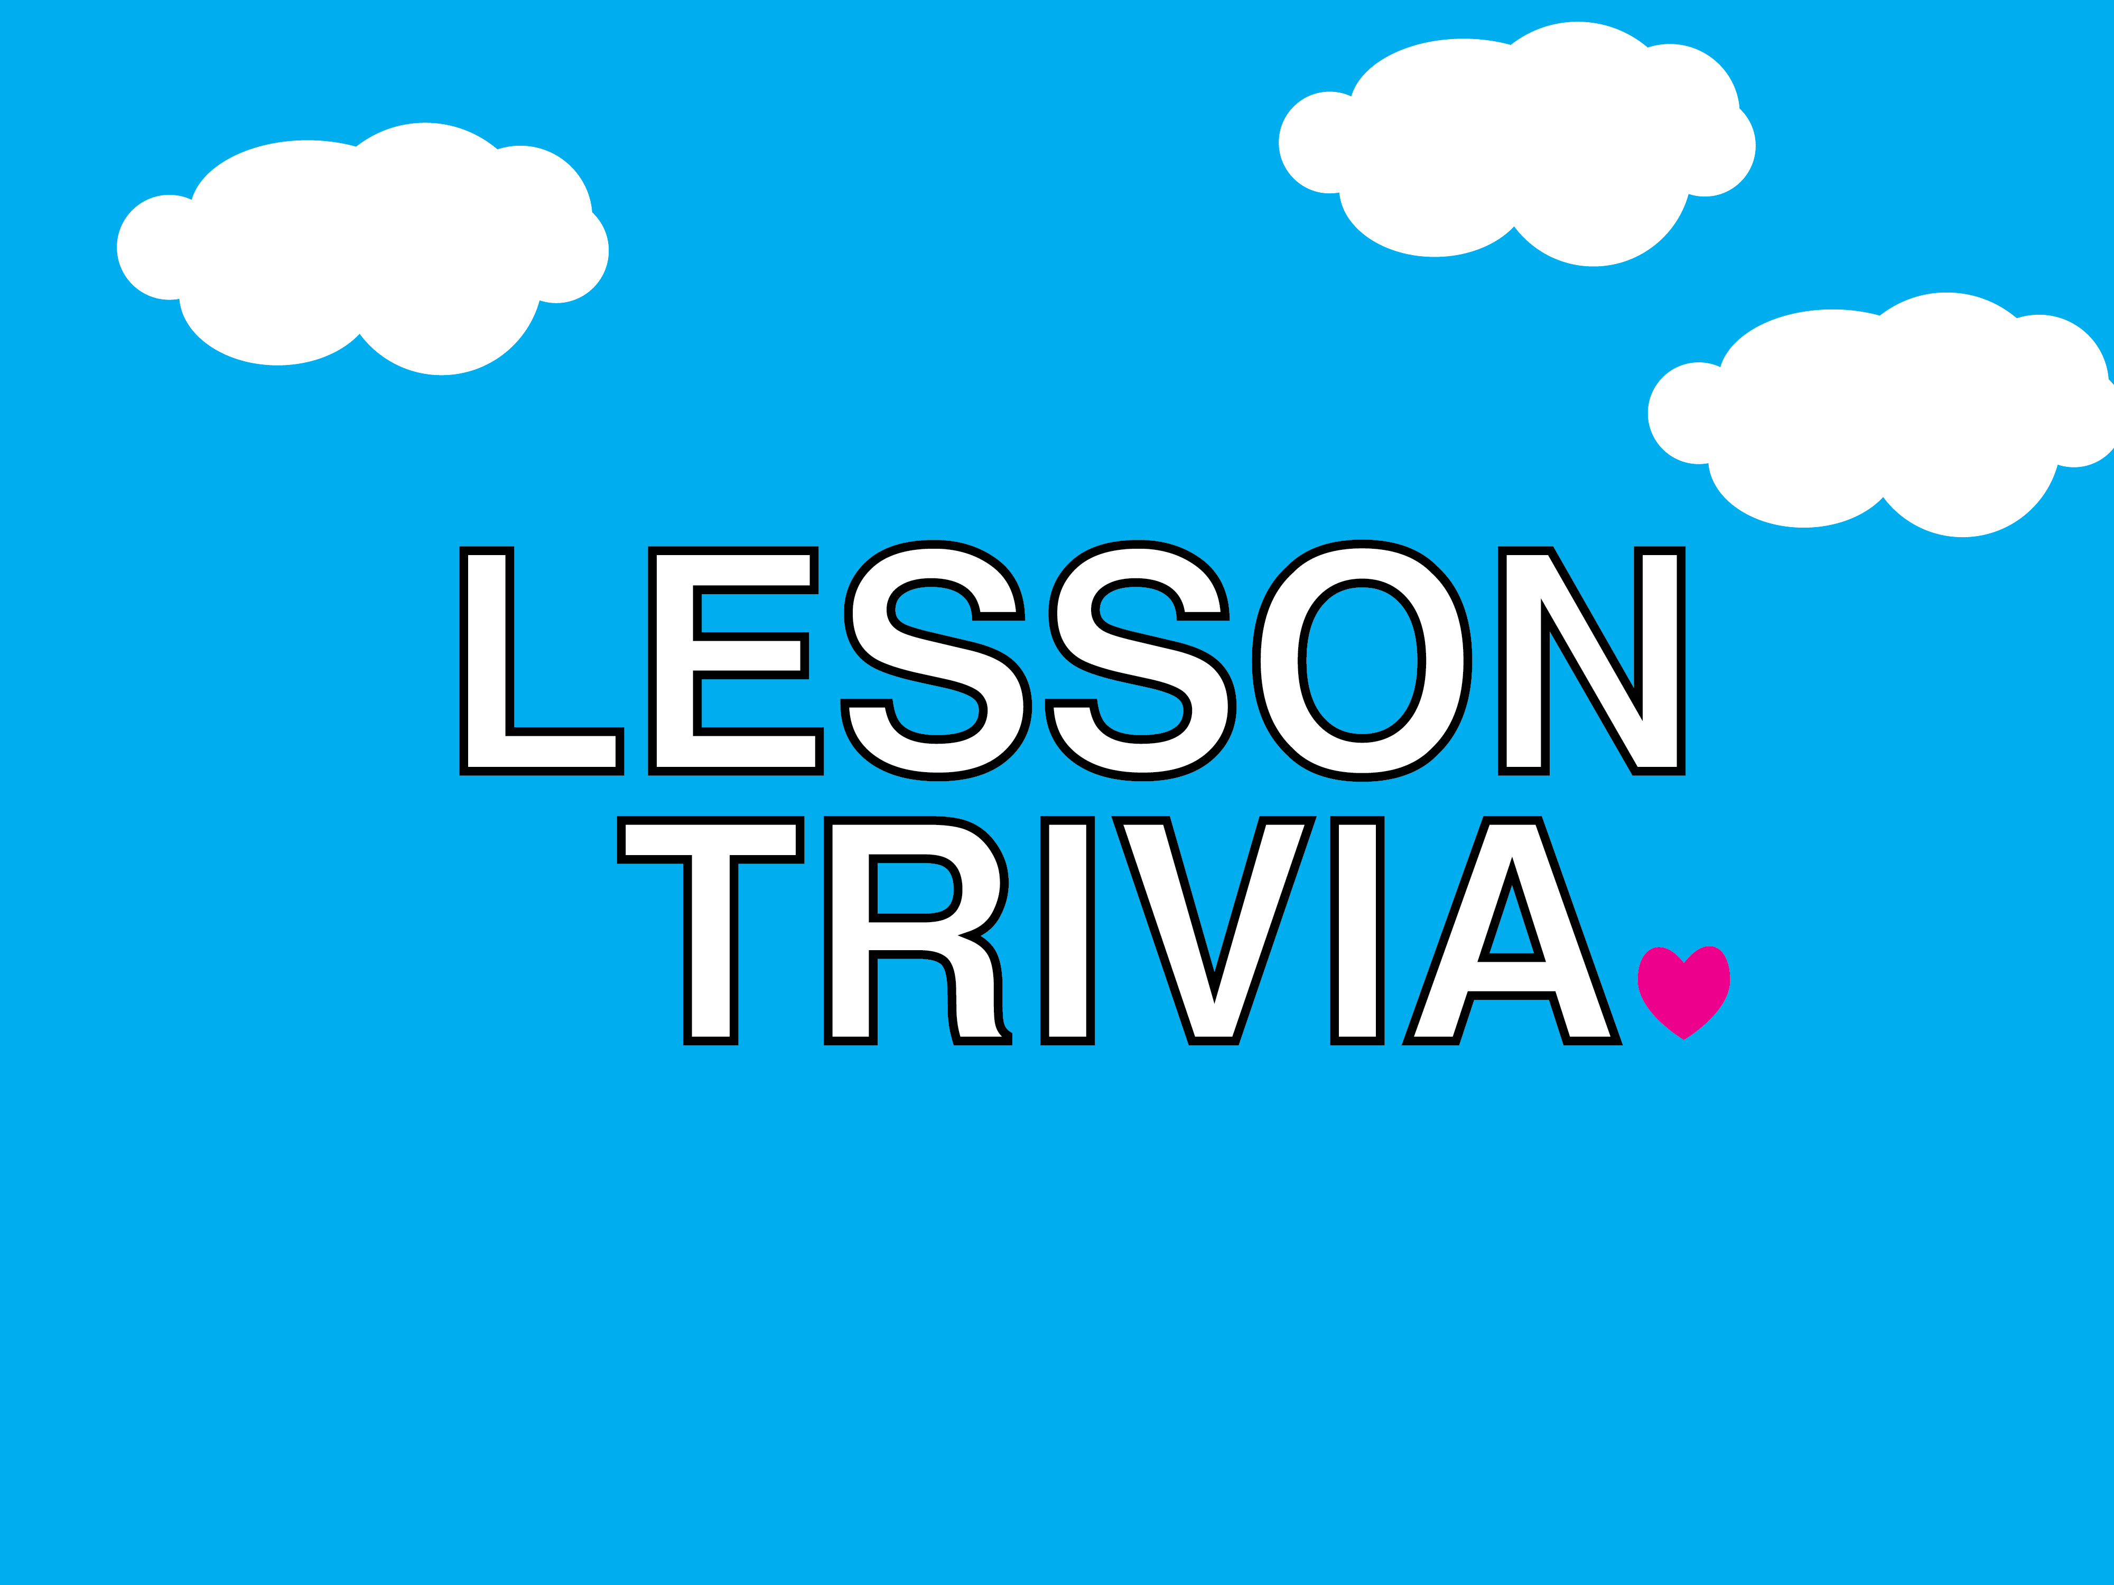

Slide 2
HOW TO PLAY
Complete the following statements about today’s lesson.

Slide 3
1. The second greatest commandment is to love your __________ as yourself.

Slide 4
1. NEIGHBOR

Slide 5
2. Jesus told a ________ to explain who our neighbor is.

Slide 6
2. PARABLE

Slide 7
3. Jesus’ listeners were shocked when a __________ man became the hero of the story.

Slide 8
3. SAMARITAN

Slide 9
4. Loving our neighbor
means loving _____ one
we meet.

Slide 10
4. EVERY

Slide 11
5. When it comes to loving our neighbors, God wants us to see the whole world as our ____________.

Slide 12
5. NEIGHBORHOOD

